Slide 1
Flying Access Points Platform Proposal
Mobile phone as a platform Option

Slide 2


Overview

Slide 3
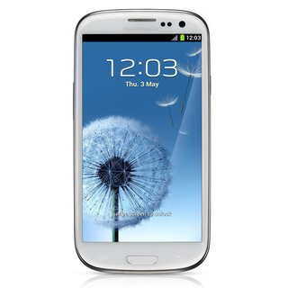
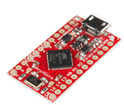
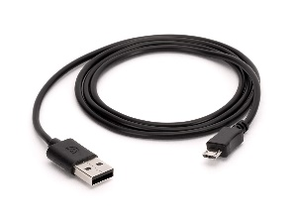
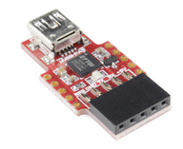

Overview: Hardware
+
+
OR

Slide 4
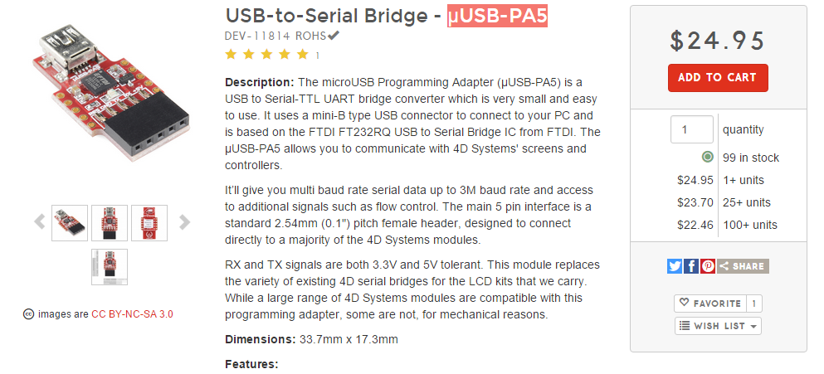
Interface Options

Slide 5
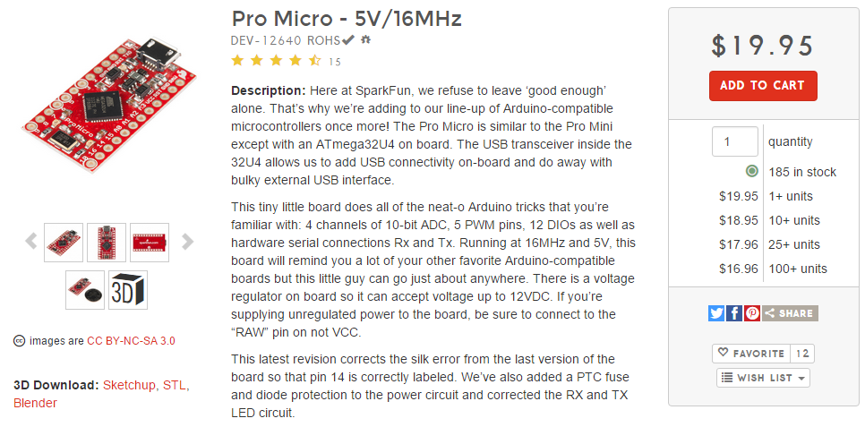
Interface Options

Slide 6
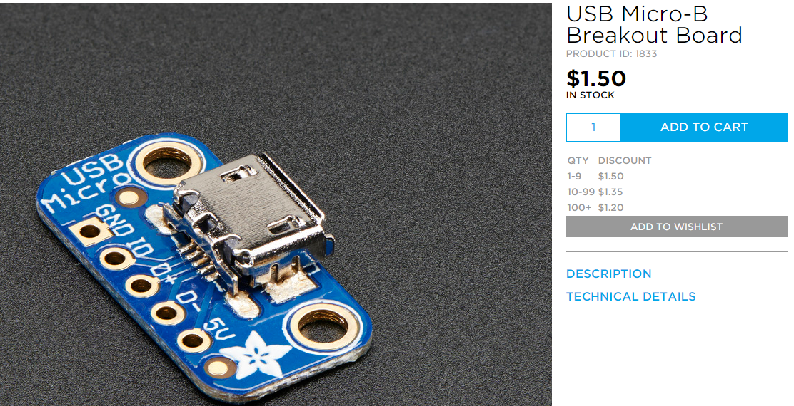
Interface Options

Slide 7

Diagram 1
Navigation Controller
µUSB-PA5
USB
GPS
CPU
Serial UART
USB
Pedometer
LTE Access Point

Slide 8
Diagram 2
Navigation Controller
Arduino µ
USB
GPS
CPU
PWM
USB
Pedometer
LTE Access Point
Other hardware

Slide 9
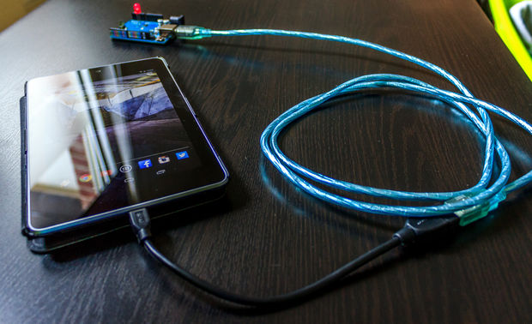
Yes!, Android+Arduino has been done before

Slide 10




Overview: Software

Slide 11


Android Libraries that do the things we need
android.net.wifi.WifiManager
http://developer.android.com/reference/android/net/wifi/WifiManager.html
android.hardware.usb
https://developer.android.com/reference/android/hardware/usb/package-summary.html

Slide 12
Android USB: Manifest
<manifest ...> <uses-feature android:name="android.hardware.usb.host" /> <uses-sdk android:minSdkVersion="12" /> ... <application> <activity ...> ... <intent-filter> <action android:name="android.hardware.usb.action.USB_DEVICE_ATTACHED" /> </intent-filter> <meta-data android:name="android.hardware.usb.action.USB_DEVICE_ATTACHED" android:resource="@xml/device_filter" /> </activity> </application> </manifest>

Slide 13
Android Wifi: Manifest
<?xml version="1.0" encoding="utf-8"?>
<manifest xmlns:android="http://schemas.android.com/apk/res/android"
package="com.example.sairamkrishna.myapplication" >
<uses-permission android:name="android.permission.ACCESS_WIFI_STATE" />
<uses-permission android:name="android.permission.CHANGE_WIFI_STATE" />
…

Slide 14
Copy-pasted example of WifiManager
import android.content.*;
import android.net.wifi.*;
import java.lang.reflect.*;
public class ApManager {
//check whether wifi hotspot on or off
public static boolean isApOn(Context context) {
WifiManager wifimanager = (WifiManager) context.getSystemService(context.WIFI_SERVICE);
try {
Method method = wifimanager.getClass().getDeclaredMethod("isWifiApEnabled");
method.setAccessible(true);
return (Boolean) method.invoke(wifimanager);
}
catch (Throwable ignored) {}
return false;
}

Slide 15
// toggle wifi hotspot on or off
public static boolean configApState(Context context) {
WifiManager wifimanager = (WifiManager) context.getSystemService(context.WIFI_SERVICE);
WifiConfiguration wificonfiguration = null;
try {
// if WiFi is on, turn it off
if(isApOn(context)) {
wifimanager.setWifiEnabled(false);
}
Method method = wifimanager.getClass().getMethod("setWifiApEnabled", WifiConfiguration.class, boolean.class);
method.invoke(wifimanager, wificonfiguration, !isApOn(context));
return true;
}
catch (Exception e) {
e.printStackTrace();
}
return false;
}
} // end of class

Slide 16
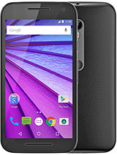
Motorola Moto G (Gen 3)
Approximate Price (SEK) | 2500 sek
Dimensions (mm) | 142.10 x 72.40 x 11.60 mm
Weight (gr) | 155
Battery capacity (mAh) | 2470
CPU | Qualcomm Snapdragon 410
GPU | None
Memory | 8 GB, 1 GB RAM 16 GB, 2 GB RAM
LTE Bands | LTE band 1(2100), 3(1800), 7(2600), 8(900), 20(800) - XT1541 LTE band 2(1900), 4(1700/2100), 5(850), 7(2600), 12(700), 17(700) - XT1540 LTE band 2(1900), 4(1700/2100), 5(850), 12(700), 17(700), 25(1900), 26(850), 41(2500) - XT1548
LTE Speed | LTE Cat4 150/50 Mbps
WLAN | Wi-Fi 802.11 b/g/n, hotspot

Slide 17

Asus Zenfone 2 ZE551ML
Approximate Price (SEK) | 2726
Dimensions (mm) | 152.5 x 77.2 x 10.9 mm
Weight (gr) | 170
Battery capacity (mAh) | 3000 mAh
CPU | Intel Atom Z3580 (4 GB RAM model) Intel Atom Z3560 (2 GB RAM model)
GPU | PowerVR G6430
Memory | 16/32/64 GB, 2/4 GB RAM
LTE Bands | LTE band 1(2100), 2(1900), 3(1800), 4(1700/2100), 5(850), 8(900), 28(700) - Taiwan LTE band 1(2100), 2(1900), 3(1800), 4(1700/2100), 5(850), 7(2600), 8(900), 20(800) - Global LTE band 1(2100), 2(1900), 3(1800), 4(1700/2100), 5(850), 7(2600), 8(900), 17(700), 20(800) - US LTE band 1(2100), 3(1800), 38(2600), 39(1900), 40(2300), 41(2500) - China & India
LTE Speed | LTE Cat4 150/50 Mbps
WLAN | Wi-Fi 802.11 a/b/g/n/ac, Wi-Fi Direct, hotspot

Slide 18
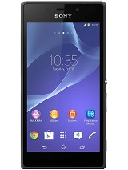
Sony Xperia M2
Approximate Price (SEK) | 1621.68
Dimensions (mm) | 139.7 x 71.1 x 8.6 mm
Weight (gr) | 148
Battery capacity (mAh) | 2300 mAh
Chipset & CPU | Qualcomm MSM8926 Snapdragon 400 (D2303, D2306) Cortex-A7
GPU | Adreno 306
Memory | 8 GB, 1 GB RAM
LTE Bands | LTE band 1(2100), 3(1800), 5(850), 7(2600), 8(900), 20(800) - D2303 LTE band 2(1900), 4(1700/2100), 7(2600), 17(700) - D2306
LTE Speed | LTE Cat4 150/50 Mbps
WLAN | Wi-Fi 802.11 a/b/g/n, dual-band, Wi-Fi Direct, DLNA, hotspot

Slide 19
Pros
Integrated components: Less prone to failure, simpler debugging.
Durable and easily replaceable.
Battery efficient.
Lightweight.
Powerful hardware.
Easier Workflow.*

Slide 20
Cons
Lack of hardware flexibility.
Requires a bridge device.
Dealing with Android (and Android Studio/Eclipse).
Extra software setup overhead: Rooting the phone and getting familiar with the libraries.

